Slide 1
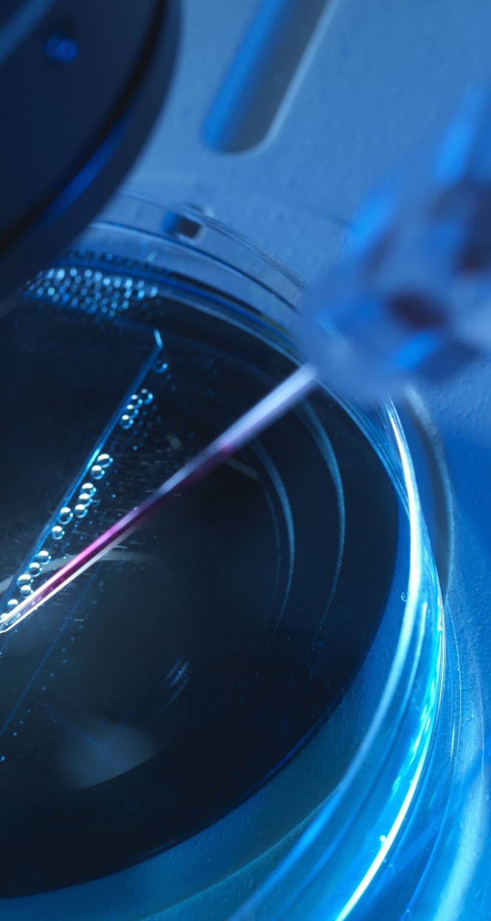
Surgical Tool Detection
AI Project Elective Term II 2022-23
FINAL RESULTS

Slide 2
Introduction
Changed XML annotations of m2cai16 into TXT format as required by YOLOv7
Trained on YOLOv7 for 350 iterations
Confusion Matrix
F1-score
mAP(mean Average Precision)

Slide 3
CONFUSION MATRIX
A confusion matrix is a matrix that summarizes the performance of a machine learning model on a set of test data. It is often used to measure the performance of classification models, which aim to predict a categorical label for each input instance
For multi-class classification, confusion matrix is a nxn matrix where n is the no.of classes
From confusion matrix, we can find:
True Positives
True Negatives
False Positives
False Negatives

Slide 4
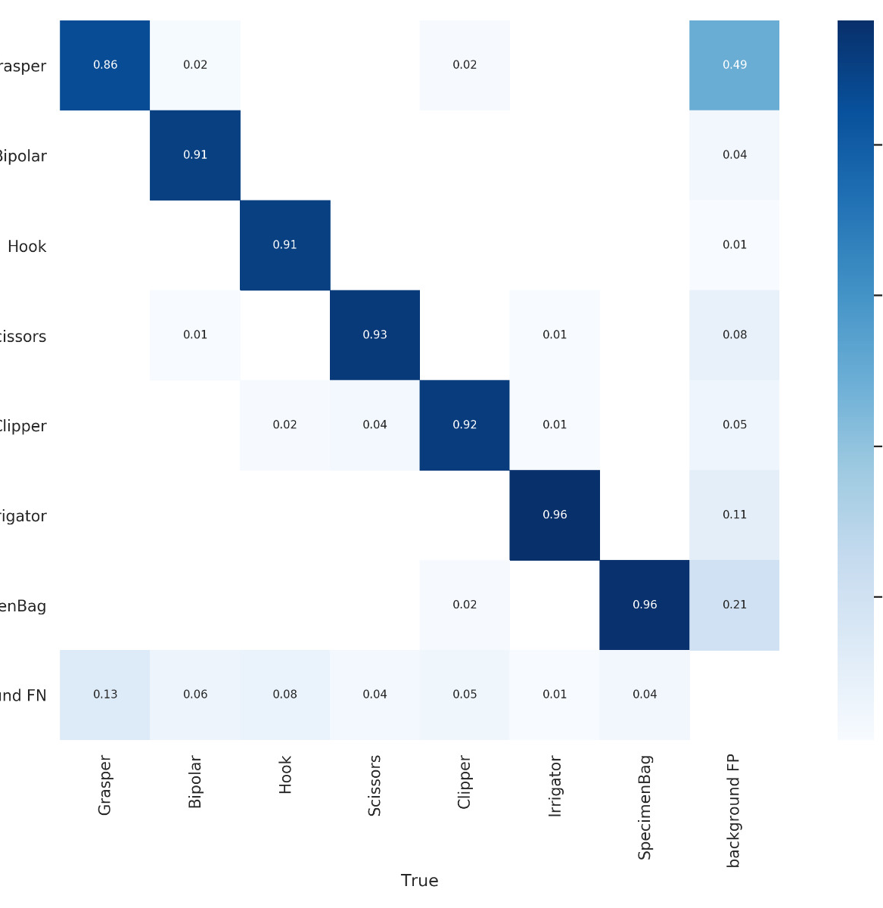
CONFUSION MATRIX
Confusion matrix for our test data after training the model for 300 iterations is:

Slide 5
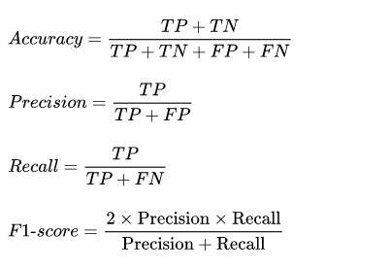
Precision, Recall and F1-score
Other metrics used – calculated based on TP, TN, FP, FN
NOTE:
Many classes – non-uniform distribution
To assess the risk of misclassification we introduce a confidence metric
So, consider these values at various levels of confidence

Slide 6
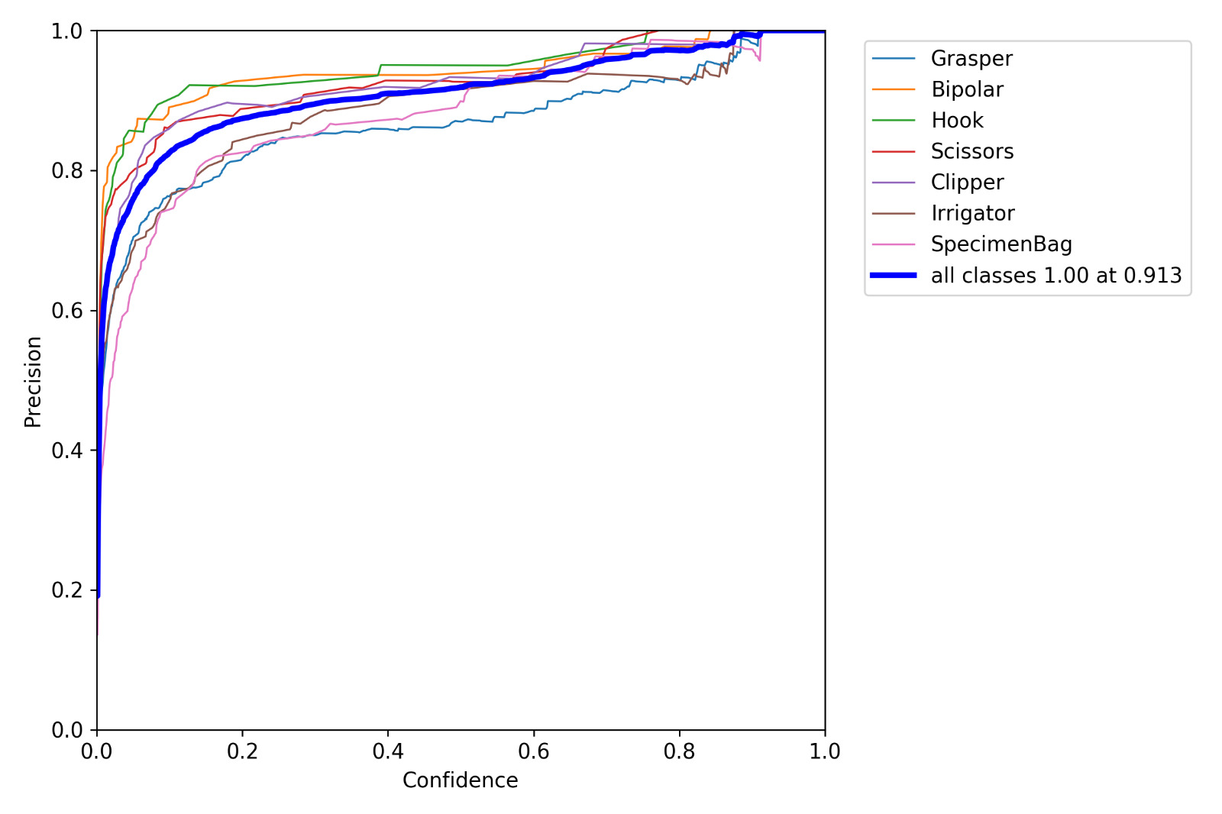
Precision vs Confidence

Slide 7
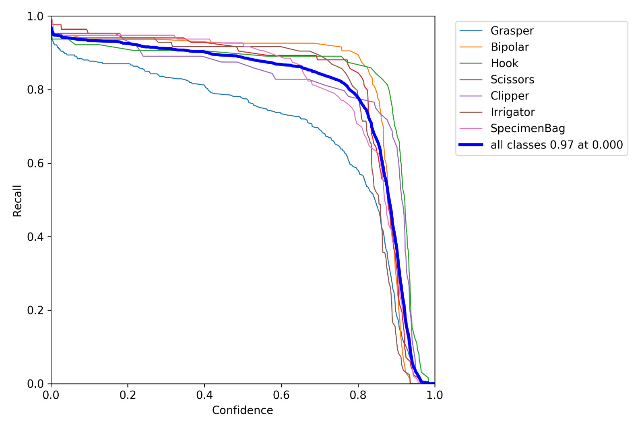
Recall vs Confidence

Slide 8
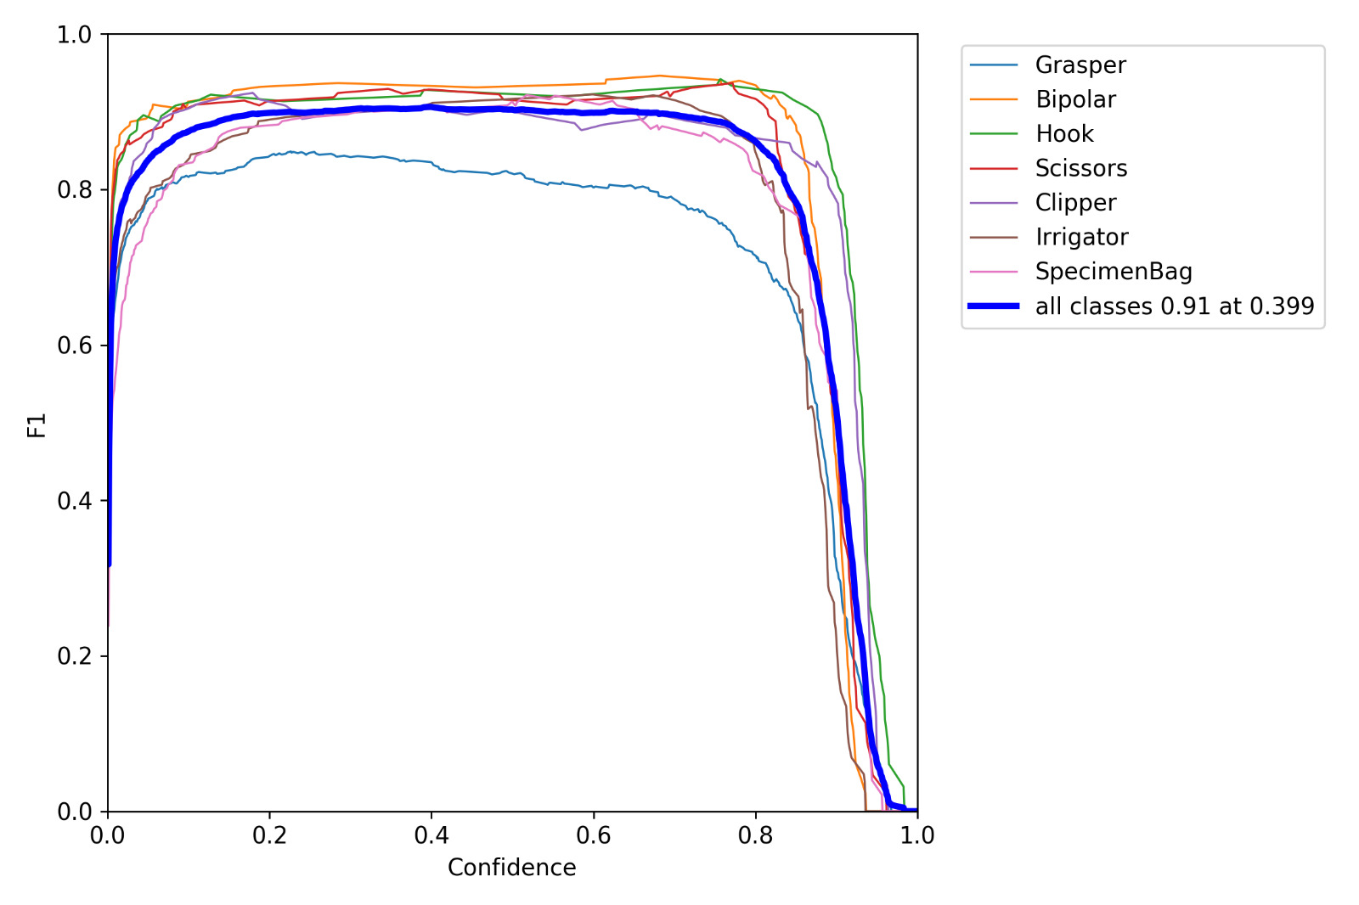
F1-score vs Confidence

Slide 9
mAP
Widely used metric for object detection task
AP(Average Precision): Average value of precision across all recall values
Mean position at 11 equally spaced [0.0, 0.1, .. , 1.0] recall values
To measure the localization efficiency – plot precision vs recall for various IoU
mAP : mean AP over all IOU and for all classes

Slide 10
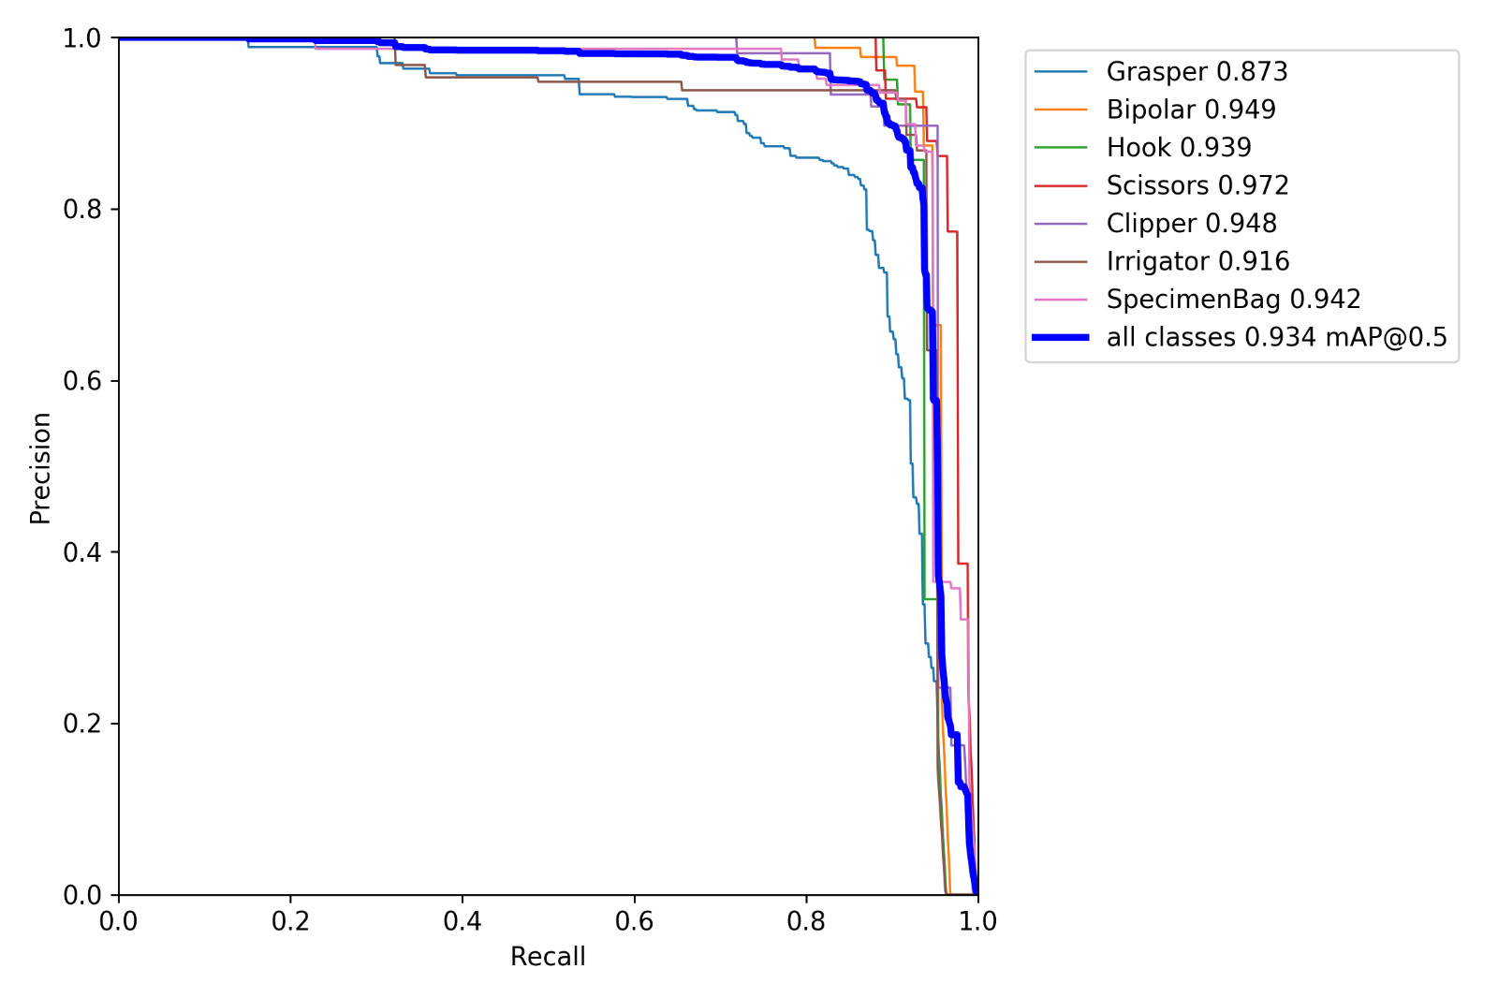
Precision vs Recall curve
This curve is plotted by taking average precisions over an IoU of 0.5.

Slide 11
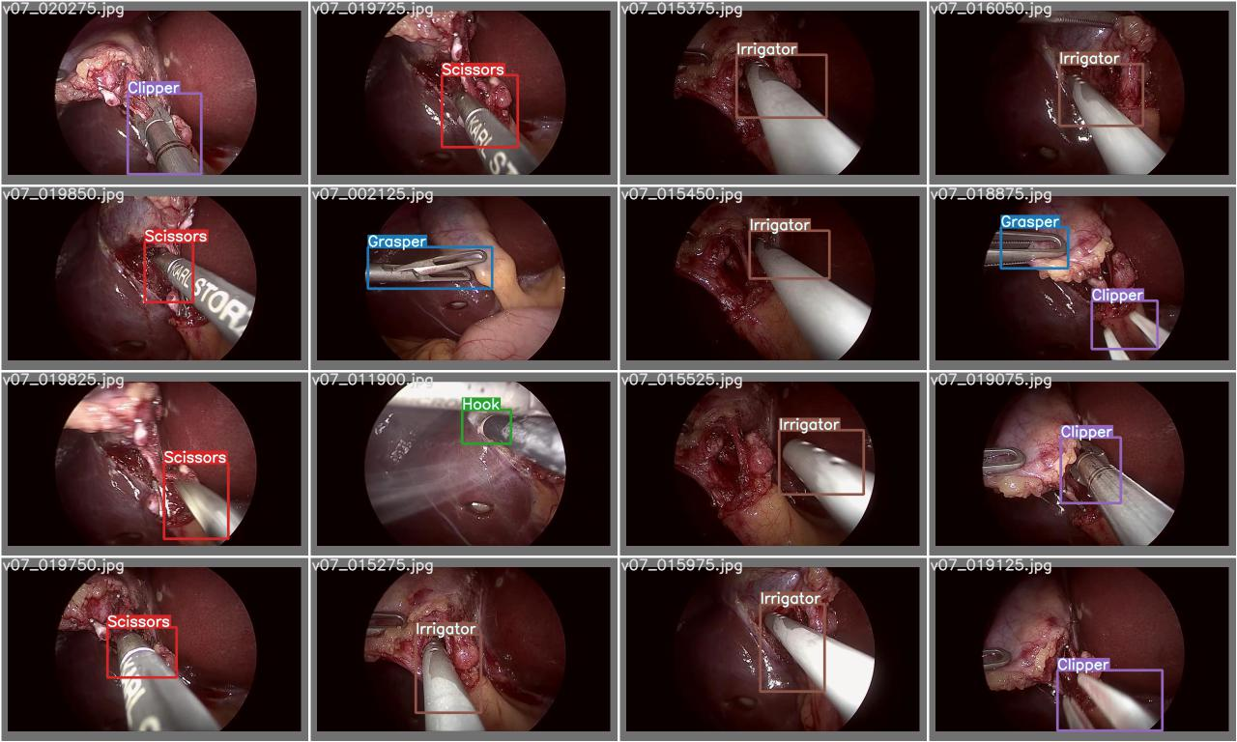
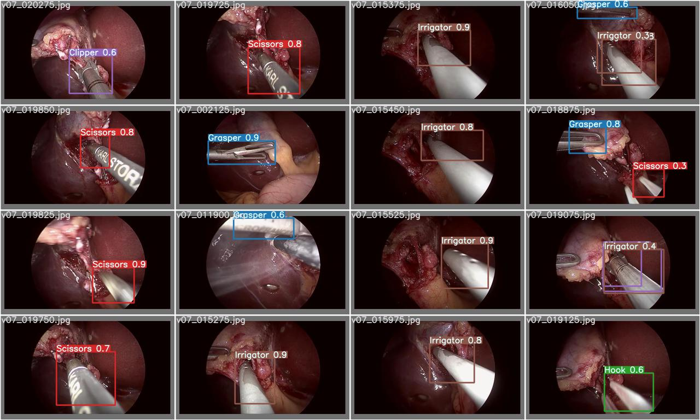
Comparisions

Slide 12
Conclusion
mAP@0.5:
For 100 iterations = 86.6%
For 250 iterations = 92.7%
For 350 iterations = 93.3%

Slide 13

N V Sai Likhith
IMT2020118

